Slide 1
TDX Live Migration
QEMU/KVM Design Doc
Presented-by: Wei Wang <wei.w.wang@intel.com>
Notes:
This doc details the QEMU/KVM design to support TD guest live migration. In general, QEMU/KVM plays the role of a courier to the TD guests states, meaning that it mostly moves the states obtained from the TDX module while the contents of the states (e.g. what kind of vCPU states need to be migrated) are managed by the TDX module and not covered by this doc. The security aspects are designed by the TDX architecture with requirements for VMMs like QEMU/KVM to follow the restrictions (e.g. migration of TD private pages need to follow some ordering enforced by the migration epoch defined by the TDX architecture). This doc doesn’t cover why/how those restrictions are designed by the TDX architecture, instead, it focuses on how QEMU/KVM is designed to follow such restrictions and how QEMU/KVM are designed to use the mechanisms supported by the TDX architecture to finish the TD guest live migration.

Slide 2
Agenda
    Introduction
    Architecture
    User Operation Workflow
    Migration Flow and TDX New APIs
    Pre-migration
    MigTD Binding
    Binding Slot States
    Migration
    Migration Data Transport
    Memory Import
    TDX Migration Driver
    Private/Shared Pages
    Dirty Page Logging
    QEMU Confidential Guest Migration Framework
    Touch Points
    KVM
    QEMU

Slide 3
Introduction

Slide 4
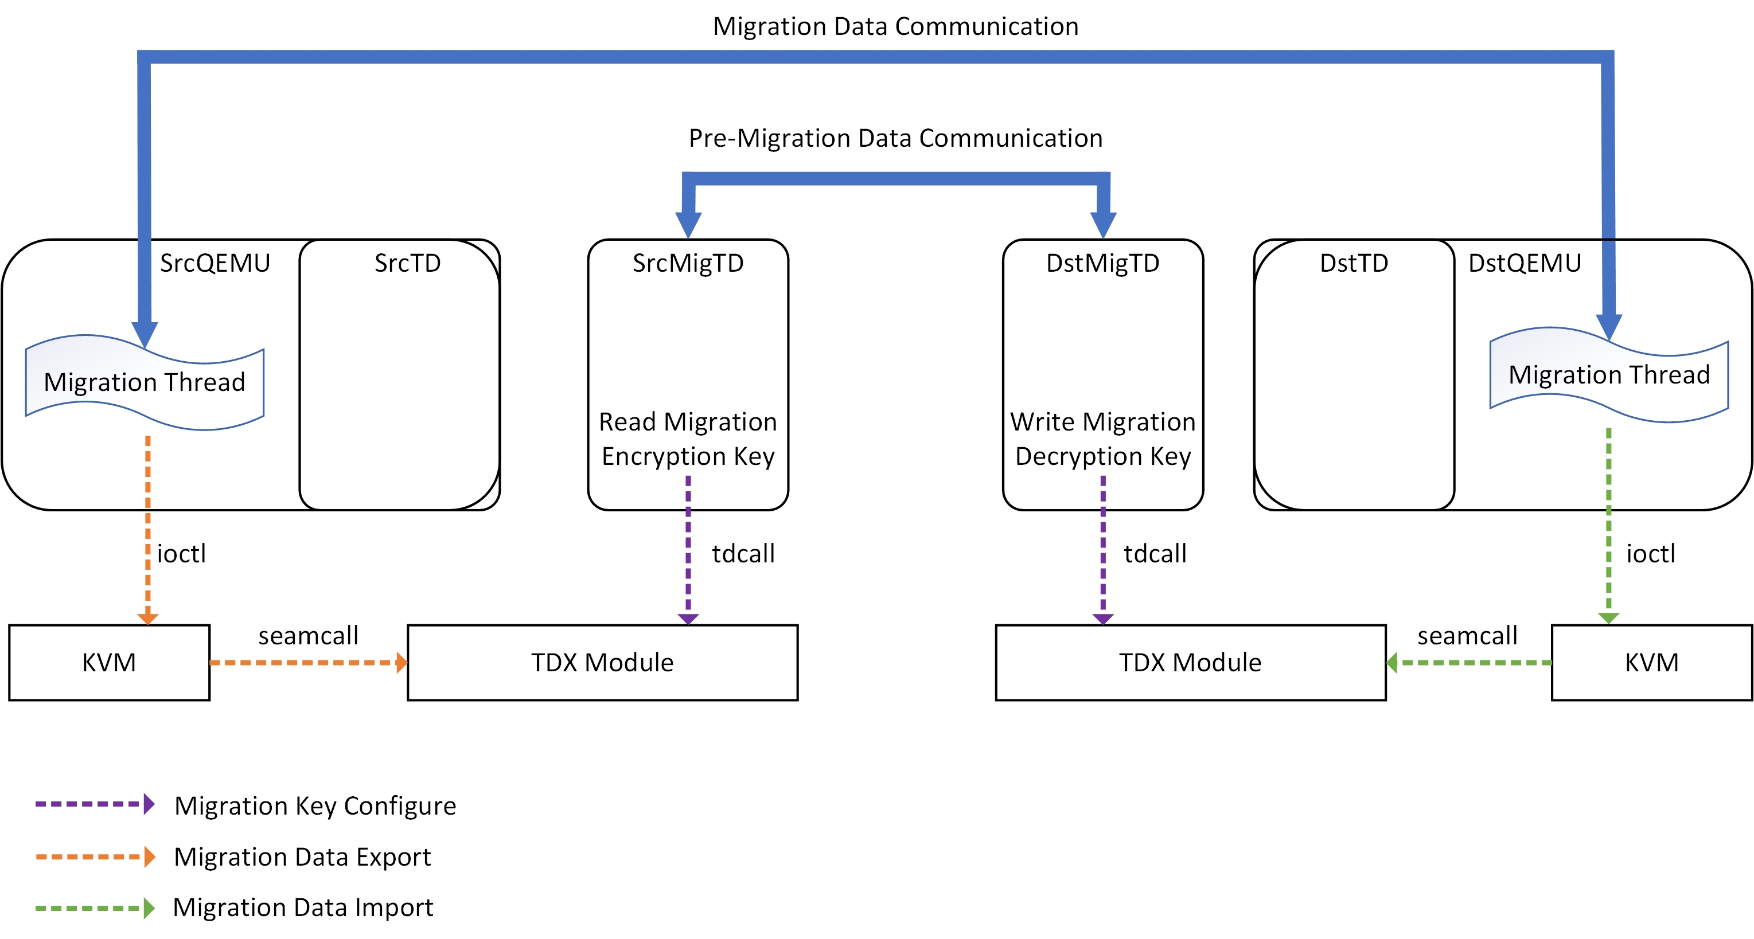
Architecture
Design in two phases
Pre-migration: preparation for migration
    Migration: migrates a running TD
Notes:
As the regular VM live migration, TD live migration also needs a destination user TD (DstTD) which imports states (e.g. memory data, vCPU states) from the source user TD (SrcTD). The whole workflow is split into 2 phases, pre-migration phase and migration phase.
Pre-migration phase:
The purpose of this phase is to do the preparation work (e.g. set up the migration key) for the later migration phase. The preparation work is driven by a special TD called Migration TD (MigTD). MigTD is launched in the same way as a regular user TD. It is bound to a user TD via a new TDX seamcall to finish the pre-migration phase for the user TD, so that the user TD can enter the migration phase later. On the source side, SrcMigTD is launched and bound to the SrcTD, and on the destination side, DstMigTD is launched and bound to the DstTD. SrcMigTD reads a migration key from TDX module via a new tdcall and send it through a secure communication channel (e.g. TLS) to the DstMigTD, and DstMigTD sets the migration key to the TDX module. The migration key will be used later in the migration phase by TDX module, on the source side to encrypt the TD’s private states and on the destination side to decrypt the received states.
MigTD is part of the TCB and included in the user TD’s attestation. Intel has a reference design (https://cdrdv2.intel.com/v1/dl/getContent/733580) and rust-based implementation for MigTD.
Migration phase:
The purpose of this phase is to live migrate a running user TD from the source machine to the destination machine. The live migration flow is driven by the migration threads (one on the source and another on the destination) in QEMU. For TD shared states (e.g. shared memory pages), they are migrated in the legacy VM migration path. For TD private states (e.g. the private memory pages, vcpu states), the QEMU migration threads send TDX migration commands (e.g. get memory data) to the TDX migration driver implemented in KVM, and the driver translates the command into the corresponding seamcall (e.g. TDH.EXPORT.MEM) to get the encrypted states from TDX module. The new TDX seamcalls used in the migration phase is documented in the TDX module v1.5 ABI spec (https://cdrdv2.intel.com/v1/dl/getContent/733579).
The migration phase doesn’t have to be entered right after the pre-migration phase is done. Instead, it can be initiated at anytime later. The first thing in migration phase is to check the pre-migration status and proceed to migrate TD states only when pre-migration has been done successfully.

Slide 5
User Operation Workflow
SrcHost
DstHost
SrcTD
Bind
SrcMigTD
DstMigTD
Bind
DstTD
Launch socat process on src and dst host
Launch src and dst MigTDs (the same way as launching a user TD)
Launch user TDs on the source and dst and bind them to the related MigTD on each side
Start pre-migration by injecting to QEMU (of SrcTD) a QOM command
Start migration by injecting to QEMU the related migration commands
TDVMCALL
Virtio-vsock
Virtio-vsock
TDVMCALL
KVM
Socat
Socat
KVM
NIC
NIC
GHCI communication
vSock communication
TCP/IP communication
TLS Session
Notes:
Above, MigTD communicates with KVM using TD.VMCALLs and follows the GHCI spec v1.5 (https://cdrdv2.intel.com/v1/dl/getContent/726792)
What’s happening after each user’s operation:
Operation 1: the two socat processes connect via TCP and wait for MidTDs to connect
Operation 2:
MigTD polls KVM for requests via TD.VMCALLs
KVM blocks the MigTD vCPUs when there is no request
Operation 3:
- Process ID of MigTD is provided as a QEMU booting parameter, and KVM uses it to find the right MigTD to bind
Operation 4:
QEMU passes to KVM the vsock port which the socat process is listening on
KVM wakes up MigTD
MigTD gets the vsock port and other related info, connects to socat, and establishes a TLS sesstion between src and dst.
- Once MigTDs finishes the setup, it tells KVM about the status (success or errors). Users may choose to terminate MigTD after this.

Slide 6
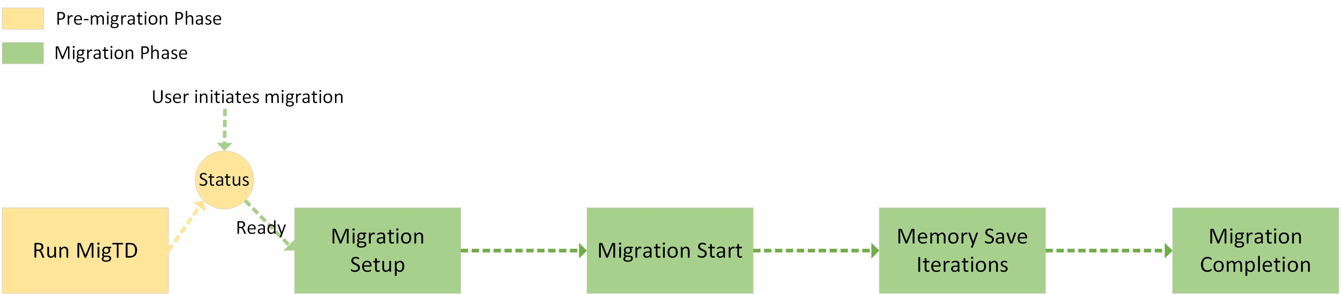
Migration Flow and TDX New APIs
KVM boots a MigTD
KVM binds MigTD to the guest TD: TDH.SERVTD.PREBIND TDH.SERVTD.BIND
SrcMigTD reads a migration key and send to DstMigTD: TDG.SERVTD.RD
DstMigTD receives the migration key and sets it to the TDX module: TDG.SERVTD.WR
Create one or multiple migration streams: TDH.MIG.STREAM.CREATE
Start dirty page logging
  Huge page split
  Write-protect TD memory (source TD only): TDH.EXPORT.BLOCKW
Migrate TD-scope Immutable states: TDH.EXPORT.STATE.IMMUTABLE TDH.IMPORT.STATE.IMMUTABLE
Start a new in-order memory migration epoch: TDH.EXPORT.TRACK TDH.IMPORT.TRACK
Remove write-protect of a private page
TDH.EXPORT.UNBLOCKW
Migrate memory pages: TDH.EXPORT.MEM TDH.IMPORT.MEM
If user requests to cancel migration: TDH.EXPORT.ABORT TDH.EXPORT.RESTORE
Pause the guest TD: TDH.EXPORT.PAUSE
Migrate the remaining memory pages
Migrate mutable TD-scope states: TDH.EXPORT.STATE.TD TDH.IMPORT.STATE.TD
Migrate vCPU states: TDH.EXPORT.STATE.VP TDH.IMPORT.STATE.VP
Ends in-order memor migration and starts out-of-order memory migration: TDH.EXPORT.TRACK(in-order-done)
TDH.IMPORT.TRACK(in-order-done)
Allow the destination TD to be un-paused and runnable: TDH.IMPORT.END
Notes:
The pre-migration phase needs to be done before the migration phase. When the user initiates the migration phase, it checks the pre-migration status and enters the migration phase only when pre-migration reports a status indicating that it is done.
TDX module added over 20 new APIs to support the whole migration flow. APIs named with TDH.* are seamcalls used by KVM to make a call to TDX module, and APIs named with TDG.* are tdcalls used by a TD (i.e. MigTD here) to make a call to the TDX module. APIs named with EXPORT.* are usually used by source side KVM, and API named with IMPORT.* are used by destination side KVM.
During pre-migration phase, 4 new APIs could be used:
TDH.SERVTD.PREBIND (optional): seamcall used by KVM to pre-bind a service TD (i.e. MigTD in the migration case) to a user TD. This is used when MigTD hasn’t been launched to run at the time of launching the user TD. A SHA384 hash value of the service TD’s TDINFO_STRUCT is provided to TDX.
TDH.SERVTD.BIND: seamcall used by KVM to bind MigTD to a user TD. It requires that MigTD has been running. The user TD and MigTDs are identified by their TDR page addresses passed to the TDX module. On success, a binding handle and the user TD’s UUID is returned to KVM, and they are passed to MigTD and used when accessing to the user TDs metadata (e.g. set a migration key) with the below 2 APIs.
TDG.SERVTD.RD: tdcall used by MigTD to read a metadata field (i.e. control structure field) of a user TD. SrcMigTD uses it to read the migration key of the SrcTD from the TDX module. A binding handle and the user TD’s UUID are passed to the TDX module. The binding handle contains information to index into the MigTD’s binding table to get the binding slot, and the UUID is checked by TDX module by comparing it with the one stored in the binding slot. On a match, the data (i.e. migration key in this case) requested by another parameter (i.e. field identifier) is returned to MigTD.
TDG.SERVTD.WR: tdcall used by a service TD to write a metadata field of a user TD. DstMigTD uses it to write the migration key to the TDX module for the DstTD. It works in a similar way as TDG.SERVTD.RD, except that it performs a write operation.
Both 3) and 4) are driven by MigTD, so we won’t see any enabling code related to them in KVM. However, KVM needs to provide the binding info (i.e. the binding handle and user TD’s UUID) to MigTD.
During the migration phase, the workflow is divided into 4 steps:
Migration Setup: this step performs some setup work for migration, e.g. start dirty page logging, create a migration stream from TDX module. Two new APIs are used in this step:
TDH.MIG.STREAM.CREATE: used by both source and destination KVM to create a migration stream and its control structure in TDX module. Migration stream is a TDX concept, analogous to a “channel” in TDX for later data export and import.
TDH.EXPORT.BLOCKW: used by source side KVM to block a list of TD private pages for writing, i.e. write-protect private pages.
Migration Start: this step starts to migrate the initial data (i.e. TD-scope immutable states) required before subsequent steps. Two new APIs are used in this step:
TDH.EXPORT.STATE.IMMUTABLE: used by the source side KVM to start a new export session and exports the TD’s immutable state.
TDH.IMPORT.STATE.IMMUTABLE used by the destination side KVM to start a new import session and imports the TD’s immutable state.
Memory Save Iterations: this step migrates guest memory pages in iterations. Each iteration goes through the dirty page logs and finds dirty pages to migrate. Seven new APIs are involved in this step:
TDH.EXPORT.UNBLOCKW: used by the source side KVM to unblock a previously blockw-ed 4KB TD private page when the user TD writes to it. Technically, this seamcall could be used in other steps during the whole migration flow.
TDH.EXPORT.TRACK: starts a new migration epoch, which will be imported to the destination side. Migration epoch is a TDX concept, and it restricts each specific page to be migrated only once during an epoch. This seamcall is invoked at the beginning of each iteration of memory page migration.
TDH.IMPORT.TRACK: consumes an epoch received from the source, meaning that a previously imported page can be re-imported from this point.
TDH.EXPORT.MEM: KVM provides a list of buffers in shared memory to export a list of private pages. The data is encrypted by the TDX module using the migration key. Data integrity of each private page is enforced by a per-page calculated MAC stored in the shared memory. A list of guest-physical addresses (GPAs), in SEPT entry format, corresponds to the list of private pages are also returned to KVM.
TDH.IMPORT.MEM: KVM provides a list of buffers, which store the encrypted private page data, MACs, GPA lists etc. received from the source, to import a list of private pages.
TDH.EXPORT.ABORT: aborts an export session and allows the source TD to resume normal operation. If migration abort is performed in post-copy, this seamcall consumes an abort token received from the destination generated by TDH.IMPORT.ABORT there. Since we don’t support post-copy right now, we can skip this part.
TDH.EXPORT.RESTORE: restores a list of TD private 4KB pages’ Secure EPT entry states after an aborted export session.
Migration Completion: this is commonly known as the “stop&copy” step, where the source TD is paused and the remaining private memory data, vcpu, and virtual device states are migrated. After this step, migration is done and the user TD will resume on the destination machine. Eight new APIs are used in this step:
TDH.EXPORT.PAUSE: used by the source side KVM to start the migration downtime period (in TDX) after paused all the vCPUs.
TDH.EXPORT.STATE.TD: used by the source side KVM to export a paused TD’s TD-scope mutable states.
TDH.IMPORT.STATE.TD: used by the destination side KVM to import the TD’s TD-scope mutable states.
TDH.EXPORT.STATE.VP: used by the source side KVM to export a paused TD’s vCPU mutable states.
TDH.IMPORT.STATE.VP: used by the destination side KVM to import the TD’s vCPU mutable states.
TDH.EXPORT.TRACK(in-order-done): same API as in step 3, but with in-order-done flag set, to indicate the in-order (i.e. memory pre-copy, where the source TD is running and private pages need to be migrated in an order enforced by the migration epoch) migration is done, and out-of-order (i.e. post-copy, where the source TD is paused, and private pages can be migrated without the migration epoch requirement) migration can start. We don’t support post-copy at this stage, so nothing is migrated after this seamcall, but this seamcall is required in the workflow for TDX to do some internal maintenance.
TDH.IMPORT.TRACK(in-order-done): ends the in-order phase on the destination.
TDH.IMPORT.END: ends an import session and allows the important TD to run.

Slide 7
Pre-migration

Slide 8
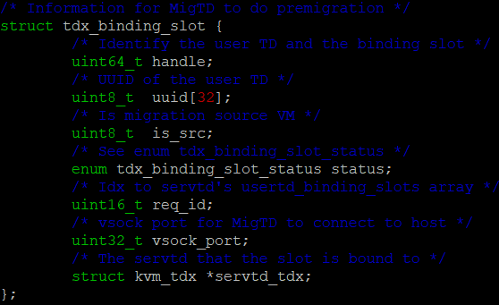
MigTD Binding
    One user TD can be bound to one MigTD, and one MigTD can be bound by multiple user TDs
    A user TD has one binding slot for MigTD
    MigTD has an array of pointers to binding slots from different user TDs
    Access to a binding slot is protected by a spin lock after it’s added to the MigTD
    Two types of binding
    Pre-binding
    Does NOT require MigTD hasn’t been running
    Performed when launching a user TD
    Passes the hash of MigTD via user TD’s QEMU booting commands, and the hash will be passed to TDX module
    Binding
    Performed either when launching the user TD or when the user TD has been running
    Requires MigTD has been running
    Passes the process ID (PID) of MigTD to the user TD’s QEMU, and KVM finds the service TD’s “kvm_tdx” struct, which contains the required info to make a seamcall to bind
Notes:
The TDX architecture supports N-to-N binding between user TDs and service TDs, meaning that a user TD can bind multiple service TDs and a service TD can be bound to multiple user TDs. For the MigTD case, we design KVM as below:
one MigTD can be bound to multiple user TDs (the max number can be obtained from TDX module via TDH.SYS.RD) as there may have multiple user TDs on the same host need to be migratable and they can share one MigTD to do the pre-migration setup; and
one user TD can be bound to one MigTD only, because the MigTD’s job is straightforward and there is no usages that require multiple MigTDs to serve one user TD so far. This can simply the KVM part design and implementation.
Binding MigTD to a user TD requires that MigTD has been running at the time of launching the user TD. To do so, user or the management software provides the process id of MigTD to QEMU/KVM (e.g. through pgrep “migtd-src”, where “migtd-src” is the process name given to the MigTD when launching it), and KVM finds the related structures of MigTD to finish TDH.SERVTD.BIND. If MigTD isn’t running at the time of launching the user TD, pre-binding can be performed, and this requires the user to provide a SHA384 hash of the service TD’s TDINFO_STRUCT to QEMU/KVM.
A binding slot (defined by “struct tdx_binding_slot”) contains all the info that’s required to support pre-migration. The slot is allocated in the user TD’s KVM control structure (i.e., “struct kvm_tdx”) and shared to MigTD’s KVM control structure by having a pointer to the slot. Since MigTD supports multiple user TDs to bind, its KVM control structure defines an array of such pointers.

Slide 9
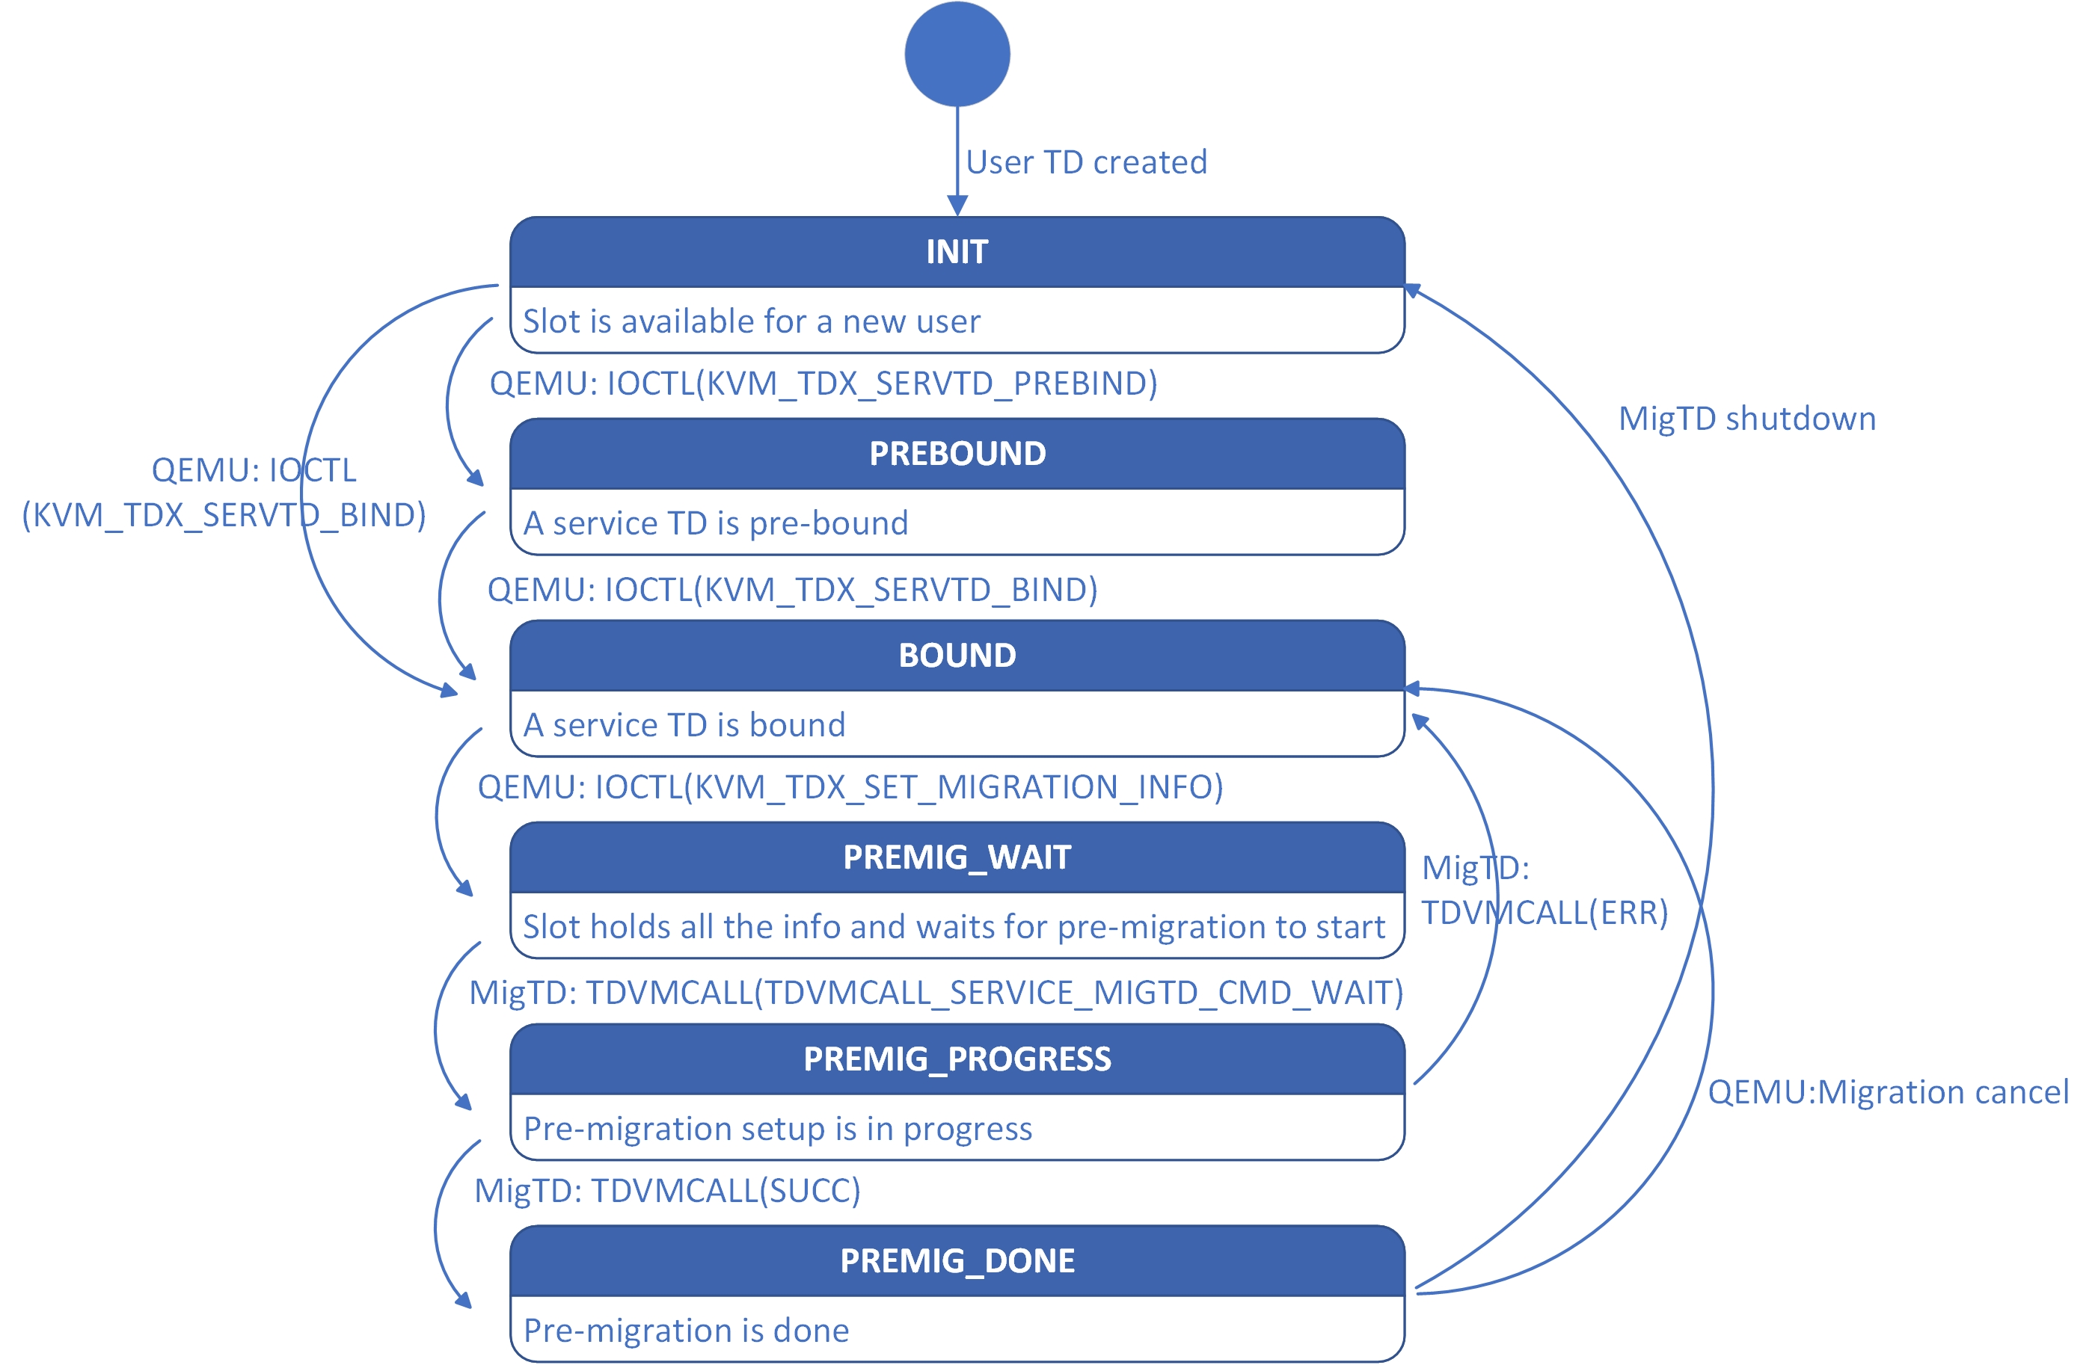
Binding Slot States
Notes:
A binding slot goes through several steps to finish pre-migration, and those steps are enforced by the binding slot’s state.
INIT: when the slot is created on TD creation, it’s put in Init state, indicating that it is available for binding.
PREBOUND: QEMU requests to do a pre-binding with the user provided hash.
BIND: QEMU requests to do a binding with a running MigTD.
PREMIG_WAIT: user requests to start pre-migration by sending a command to qemu, including the vsock port that MigTD needs to connect. This makes QEMU request KVM to set the slot state to PREMIG_WAIT, indicating that it is waiting for pre-migration to start. MigTD is designed to poll for slots which are in PREMIG_WAIT state.
PREMIG_PROGRESS: once MigTD requests to KVM via TDVMCALL to read the info stored in the slot, the slot is put in this state to indicate it is in progress of pre-migration.
PREMIG_DONE: when MigTD finishes pre-migration, it reports the pre-migration status to KVM. If it is a success, the slot is put in this state, otherwise, it transit to BOUND state, waiting for the user to request to do pre-migration again (e.g. after fixing some network issues). If migration is cancelled, it also goes back to the BOUND state. This allows the user to request to do pre-migration again, e.g. with a new destination MigTD.
When MigTD is shutdown, the binding relationship ends, so the slot state is reset to INIT.

Slide 10
Migration

Slide 11
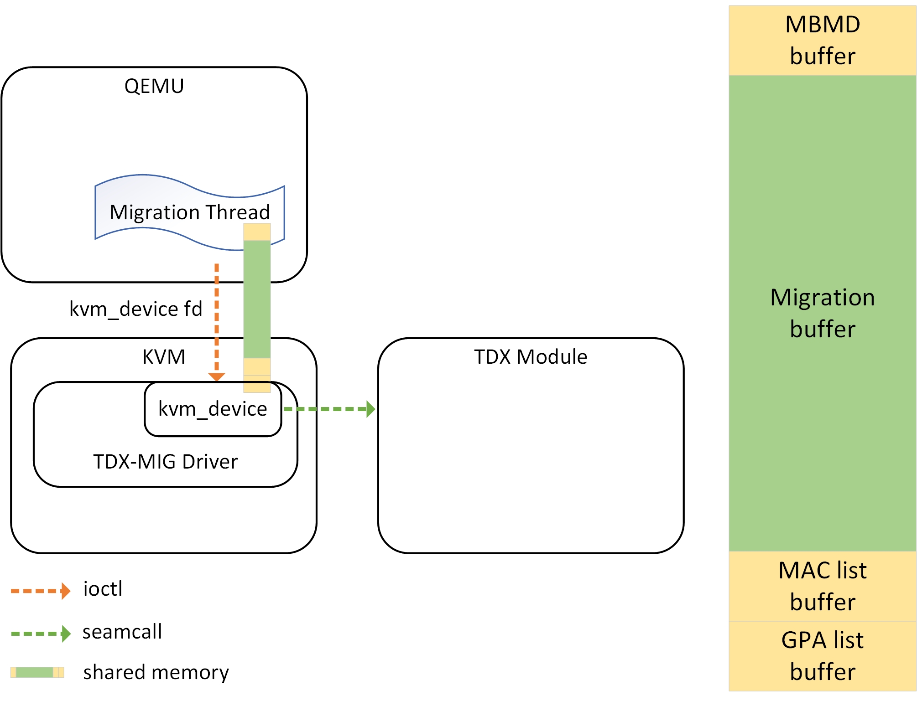
Migration Data Transport
A migration stream creates a kvm_device
  QEMU migration thread ioctls on the device fd to send requests, e.g. export states
  KVM device allocates a piece of memory mapped by the migration thread to transport the exported states
    The memory is also given to TDX Module to export/import the encrypted states
  Shared Memory
  MBMD buffer stores the migration bundle metadata
  Migration buffer stores the exported or imported states
  Mac list buffer stores a list of MACs corresponding to the TD private pages in the migration buffer
  GPA list buffer stores a list of GPA entries corresponding to the TD private pages in the migration buffer
  Multifd supports multiple migration streams, so multilpe migration devices are created in KVM
  Each device shares a piece of memory with its mutifd iothread
Notes:
The live migration logic is in QEMU, and the seamcalls are invoked from KVM. There will frequent communication between QEMU and KVM. A “tdx-mig” driver is added to KVM to provide support for the communication. The driver builds communication channels for QEMU to based on the exiting kvm_device (more details in later slides).
By default, QEMU only has one migration thread to handle the migration data. The migration thread requests the tdx-mig driver to create one communication channel. The driver will make a seamcall (i.e. TDH.MIG.STREAM.CREATE) to TDX module to create a migration stream inside TDX module, create one kvm_device and have the device fd returned to the migration thread. During the migration phase, the migration thread performs ioctls on the fd to send commands to the driver, e.g. export a private page at GPA 123, then the driver translates the command into the seamcall (i.e. TDH.EXPORT.MEM) to get the page from tdx module.
Another important part of the communication channel is the data plane, which is built using shared memory. The memory is allocated by the driver per channel (i.e. per kvm_device) and shared to the migration thread to map. The memory is also passed along with the seamcalls to the TDX module to load the TD states (private memory data, vcpu states etc.). On the source side, once the export seamcall is done, the data is in the shared memory directly accessible to the userspace migration thread to send. On the destination side, the migration threads loads data into the shared memory directly from the network, and the memory is passed to the TDX module via the IMPORT seamcalls. We have some optimizations of using the shared memory on the destination and will be introduced in the next slide.
With the multifd feature enabled, QEMU creates multiple IO threads to handle migration data in parallel. In this case, each IO thread requests the driver to create a communication channel, and those threads can request the driver to export/import states in parallel.

Slide 12
Memory Import
In-place Import: Pages imported to TDX module become TD private pages
Non-in-place Import: Data in pages imported to TDX module are copied to TD private pages
Pages from private fd (UPM)
Secure EPT Table
TD Private Pages
TDH.MEM.IMPORT with in-place import
  If the page is the first time import:
  Copied to UPM page by KVM
  Filled by the QEMU migration thread
If the page isn’t the first-time import (i.e. dirty page) :
TDH.MEM.IMPORT with non-in-place import
Network
Shared Memory
Notes:
Memory import on the destination is a bit special, as the TDX architecture supports two types of memory import, configurable via parameters of TDH.IMPORT.MEM:
* In-place Import: Pages imported to TDX module become TD private pages. This is used for the first time when a private page gets imported.
* Non-in-place Import: Data in pages imported to TDX module are copied to TD private pages. This is used when a private page is re-imported.
To facilitate in-place import and increases the migration performance, two things are done before memory import:
When booting the destination side QEMU, the private fd-based memory are mapped by QEMU, and the mapped memory are pre-allocated.
After TD’s immutable states are imported, KVM pre-allocates all the secure EPT tables, except leaf entries, for the destination TD.
When migration data of a private page is received from network, the migration thread check if this page is the first time imported:
- if yes, put the data into the corresponding QEMU mapped page, and send a request to the tdx-mig driver to do in-place import of this QEMU page. This page then becomes the TD private page pointed by the leaf entry in the sept table.
- If no, put the data into the shared memory, and send a request to the tdx-mig driver to do non-in-place import. TDX module will copy the data (with decryption etc.) into the corresponding TD private page that has been set up in SEPT when the page was first time imported.
When migration is done, un-map the private memory from QEMU and set the private fd to be inaccessible before the TD resume to run.

Slide 13
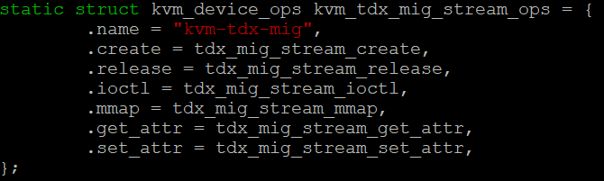
TDX Migration Driver
QEMU usage example:
  Create a kvm device and migration stream from TDX module
  Device fd returned for the following interactions
  Set device attributes
  If current QEMU migrates one page each time, set the buffer size to 4KB
  Get device attributes
  Get the buffer sizes for mbmd, mac list etc.
  Map the shared memory buffers
  During the migration process, sends TDX migration commands to the tdx-mig driver via ioctl
  e.g. export/import immutable states, pause
  Once migration done, close the device fd
tdx_mig_stream_create
  Create a migration stream from TDX module
  tdx_mig_stream_release
  Free the allocated resources
  tdx_mig_stream_ioctl
  Main interface for migration cmds between QEMU and KVM , e.g. export/import memory, immutable states
tdx_mig_stream_mmap
  Share memory to QEMU to achieve 0-copy of exported/imported migration data
  tdx_mig_stream_set_attr
  Set the configurable device attribute, e.g. buffer size for migration data
  tdx_mig_stream_get_attr
  Get attributes related to the migration device, e.g. mbmd buffer size, mac list buffer size

Slide 14
Private/Shared Pages
KVM uses Xarray to track (implemented by the UPM patchset)
  Linux specific data structure
QEMU uses bitmaps to track
  Guest private<-->shared page conversion exits to userspace, QEMU implements bitmaps (named cgs_bmap, and allocated per ramblock) to record the private/shared info for userspace to reference
  Migration Support
  Private/Shared pages are sent through the same channel (e.g. same socket connection) with different flags
  New ram flag RAM_SAVE_FLAG_CGS_STATE to tell the destination side the page is private
  The destination side checks if the received page’s shared/private state is consistent with that in cgs_bmap
  If no, need to update cgs_bmap and convert shared to private (or private to shared) via the interface provided by UPM
Notes:
A TD guest can have both private and shared memory pages. KVM has used xarray to track if a page is private or shared, but Xarray is a Linux specific data type and QEMU doesn’t support it. QEMU is designed to use bitmaps (named cgs_bmap) to record if a page is private or shared. Initially all the pages are treated as private pages, whenever the guest converts a page from private to shared or the other way around, KVM always exits to QEMU with KVM_EXIT_MEMORY_FAULT reason (this is the existing support from UPM), and then QEMU records the bit in cgs_bmap (set for being shared and cleared for being private).
The shared pages are migrated in the same way as legacy VM migration, where the migration thread direct reads/writes the date in plaintext from/to the page that has been mapped into the virtual address space of the QEMU process. The private pages are migrated via the new mechanism introduced in this doc. Though the way of getting the page data is different for shared and private pages, they are finally sent through the same channel (e.g. socket) with different flags. When sending a private page, a new ram flag is added, RAM_SAVE_FLAG_CGS_STATE. The receiver side knows if the page it received is private or shared via checking if the flag is set or not, and it checks if the state is consistent with that recorded in cgs_bmap. If not, it updates the bitmap and goes through the interface provided via UPM (i.e. kvm_convert_memory) to convert the page between shared and private.

Slide 15
Dirty Page Logging
PML isn’t supported by the current TDX module, and write-protection is used
  enable_pml is set to false for the tdx case during vt_hardware_setup
Reuse the implementation of dirty logging with write-protection for the legacy VM migration, and patch the vendor specific “changed_private_spte” to write enable/disable SPTEs of private pages
  If old spte was writable and new spte is non-writable, invoke TDH.EXPORT.BLOCKW to write-block the page
  If old spte was non-writable and new spte is writable, invoke TDH.EXPORT.UNBLOCKW to write-unblock the page

Slide 16
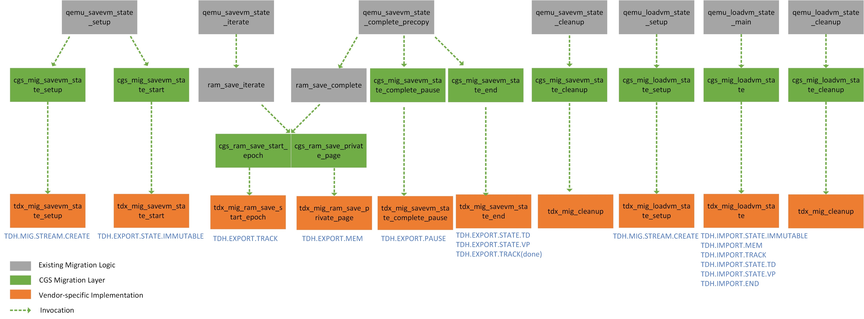
QEMU Confidential Guest Migration Framework
Source
Destination
Notes:
The design presented in this figure are all implemented in QEMU. The grey boxes in the figure outlines the existing migration logic in QEMU, with the left side (to the red line) being performed by the source migration thread and the right side being performed by the destination migration thread. The green boxes are the new confidential guest (cgs) migration framework introduced by the design. The orange boxes are the vendor specific implementation and optionally hooked to the cgs migration framework. For the TDX live migration case,
on the source side:
At the migration setup (i.e. qemu_savevm_state_setup) step, the migration thread sends a command to the tdx-mig driver to create a migration stream, and then export the TD-scope immutable states from the TDX module and send to the destination.
At the memory pre-copy (i.e. ram_save_iterate) step, a migration epoch is exported and sent at the beginning of each iteration. When sending a page, if the cgs_bmap indicates that it is a private page, it goes to the cgs path (i.e. cgs_ram_save_private_page) to export the page from TDX module and send it with RAM_SAVE_FLAG_CGS_STATE or-ed to the existing ram flag.
When the migration thread enters the stop&copy step (i.e. pause the guest), the migration thread requests KVM via the cgs framework (i.e. cgs_mig_savevm_state_complete_pause) to notify the TDX module (via the TDH.EXPORT.PAUSE seamcall) to enter the downtime period.
At the stop&copy step, cgs_mig_savevm_state_end calls into the TDX implementation to export the TD-scope states, vCPU states and the start token to send to the destination.
Finally, when the migration is done, the tdx_mig_cleanup callback is invoked to do some housekeeping work, e.g. un-map the shared memory, close the fd of the kvm_device.
on the destination side:
The setup work is similar to that in the source side, except it is invoked from the migration load setup path (i.e. qemu_loadvm_state_setup).
The TD states loading path is relatively simpler on the destination side. The states data are packaged by the TDX module into a migration bundle with a header in clear text and data in cipher text. When the migration thread on the destination receives a migration bundle, it
1) reads the “states type” (e.g. TD-scope immutable states or memory states) from the header;
2) copies the migration bundle into either shared memory or related QEMU mapped page if it is the first time of importing the memory page;
3) sends the corresponding command to the tdx-mig driver.
- When the migration is done, the tdx_mig_cleanup is invoked as that in the source side.

Slide 17
Touch Points

Slide 18
KVM
    Pre-migration
vmx/tdx.c and vmx/tdx.h
    MigTD binding
    TDG.VP.VMCALL<Service> (i.e. GHCI spec 3.13) handling to communicate with MigTD
    Set/get migration info from/to QEMU (e.g. set vsock port or get pre-migration status)
    coco/tdx/tdcall.S and vmx/tdx_ops.h
    Extend the seamcall to input and output more parameters
    Migration
    New file: vmx/tdx_mig.c
    Implements a tdx-mig driver (build shared memory, handle migration commands from userspace etc.)
    vmx/tdx.c
    Refactor some code in functions to be called from tdx_mig.c, e.g. pre-allocate sept tables after importing immutable states
    Skip some operations for the destination TD initialization
      Some operations are not needed, e.g. TDH_MNG_INIT
      Some operations are performed after the TD and vCPU states are imported, e.g. setting SHARED_EPT_POINTER
    mmu/tdp_mmu.c and vmx/tdx.c
    Perform write enable/disable for private pages by calling to tdx specific functions

Slide 19
QEMU
    Pre-migration
target/i386/kvm/tdx.c and tdx.h
    New object property to TDX_GUEST, e.g. migtd-pid
    Migration
New file: migration/cgs.c
    cgs migration framework APIs for confidential guest migration
New file: migration/cgs-tdx.c
    TDX specific implementation hooked to the framework APIs
    migration/migration.c, savevm.c and ram.c
    Intercept the migration flow to invoke the framework APIs to migrate confidential states (setup, memory states, vcpu states, cleanup etc)
    i386/kvm/kvm.c
    Some vCPU emulated states (e.g. MSRs) still need to be migrated in the TDX case

