Slide 1
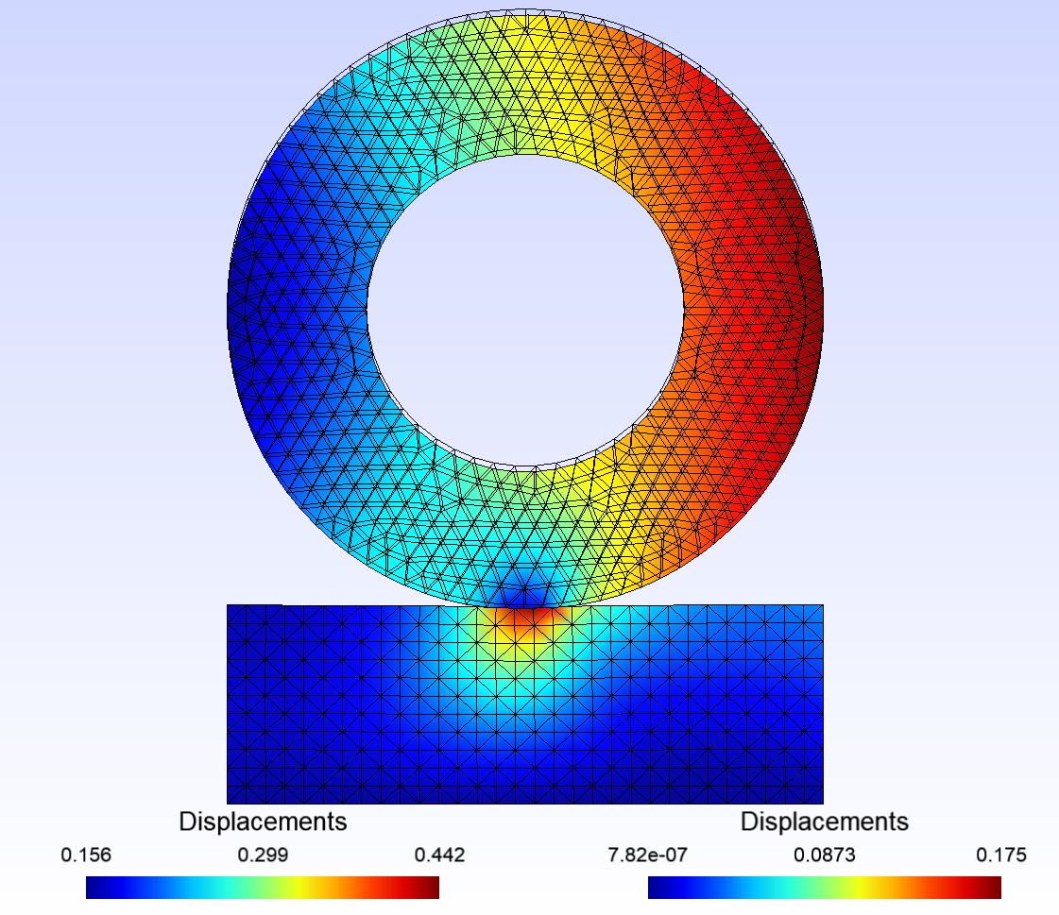
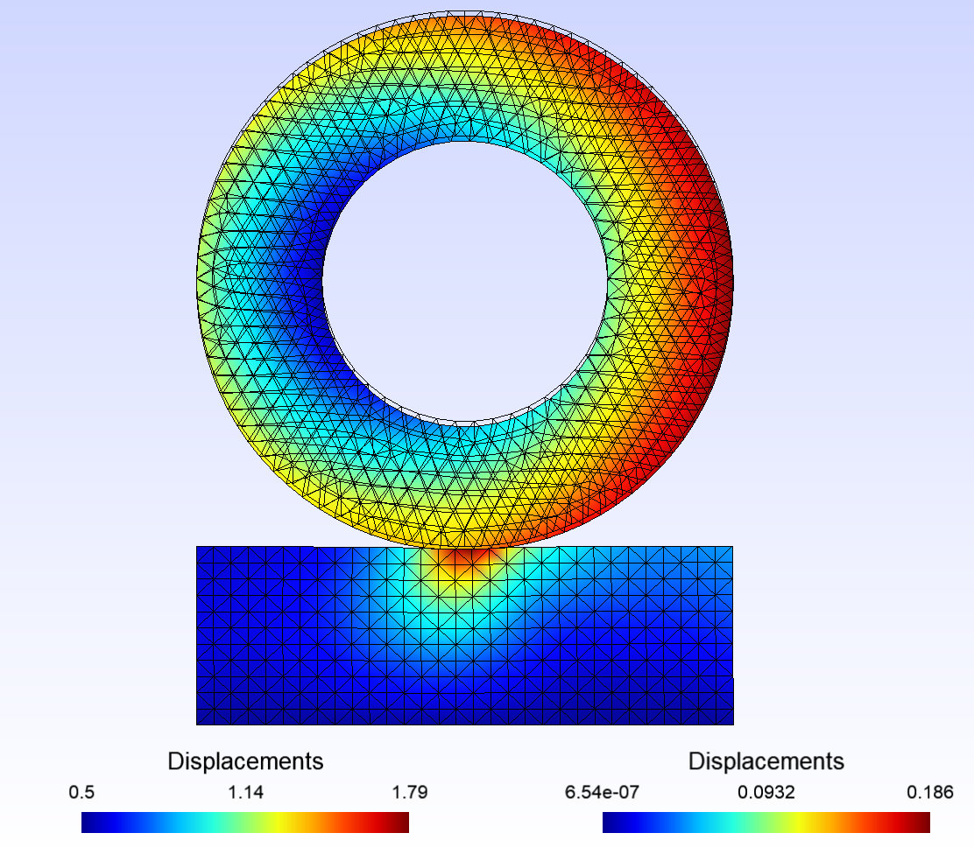
Run demo_wheel_contact.py
Original script phi = 0.01 # rotation angle
phi = 0.1 # rotation angle
Seems reasonable

Slide 2
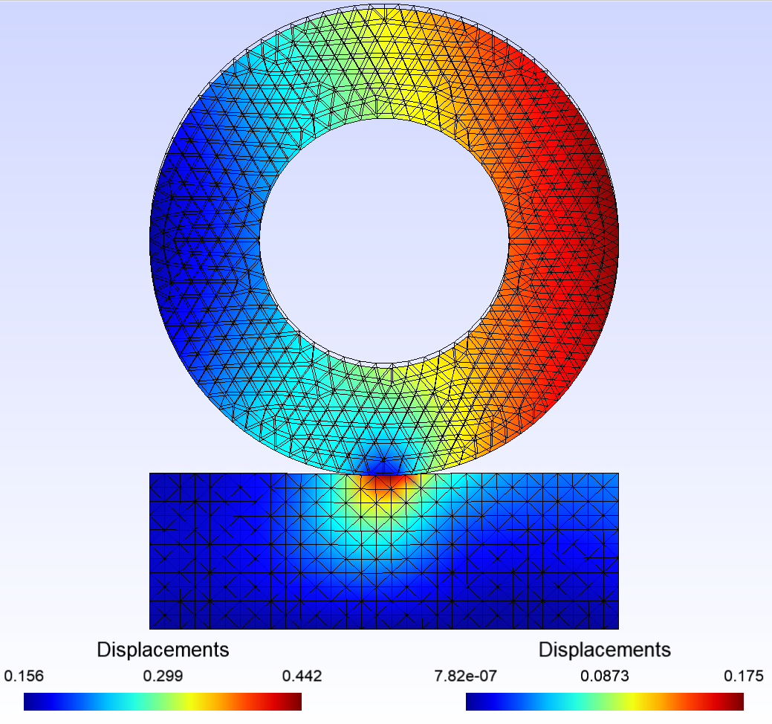
Run demo_wheel_contact.py
Original script applied_force = 1E7 # Force at the hole boundary (N)
applied_force = 0 # Force at the hole boundary (N)
Force value has non impact on result (normal given the gwfl formulation, right?)

Slide 3
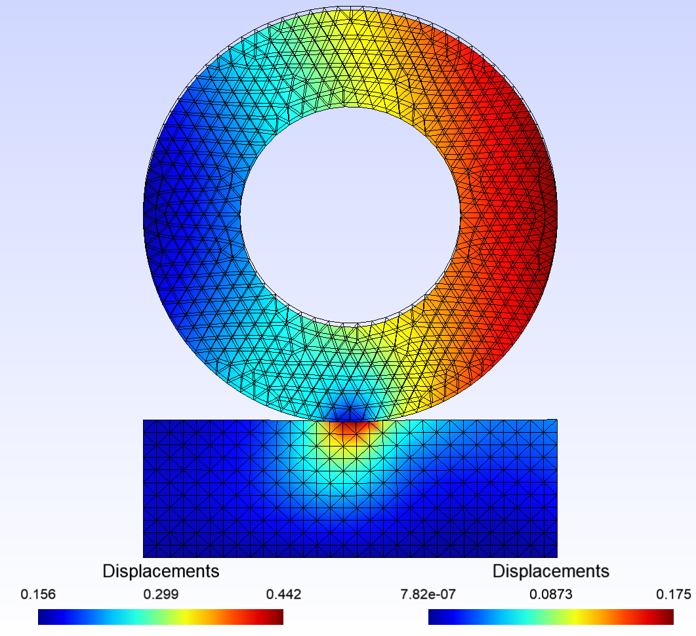
Run demo_wheel_contact.py
Adding horizontal Force
Horizontal force
has non impact on result either
Is it normal?

